Slide 1
Prototype

Slide 2
Something about OOP
Abstraction
Inheritance
OOP
Polymorphism
Encapsulation

Slide 3
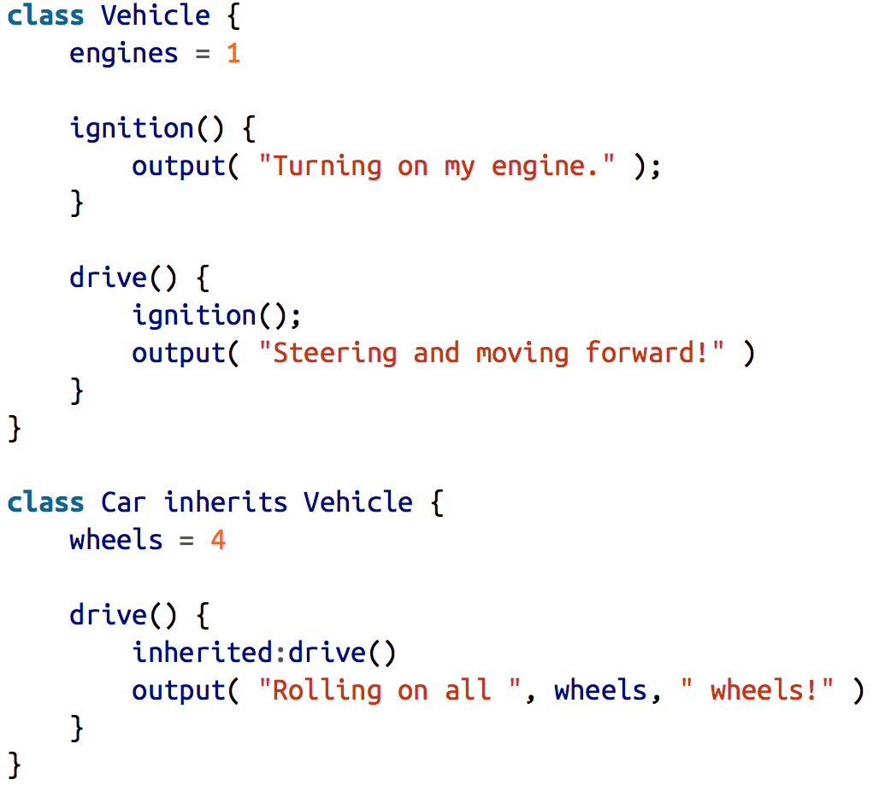
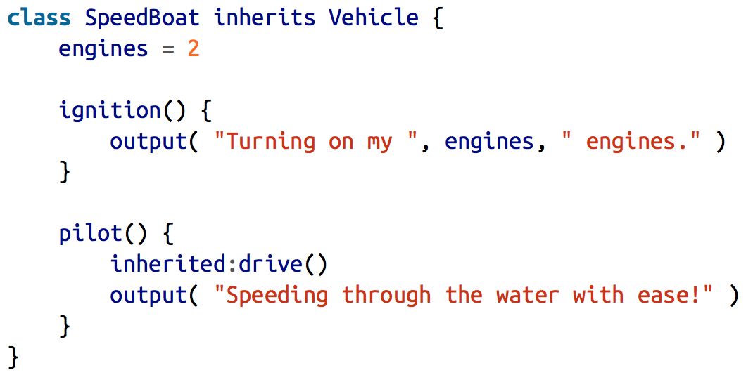
Simple example

Slide 4
Class vs instance

Slide 5
JS OOP

Slide 7
To know
JavaScript is more about functional programing than OOP
JavaScript has no classes
JavaScript work is oriented to objects
JavaScript only emulates the true OOP principles

Slide 8
Mixins
Mixins are the initial attempt to implement some kind of OOP in JS
Mixins is all about copying behavior from one object to another to simulate inheritance
There are 2 types of Mixins: explicit and implicit

Slide 9
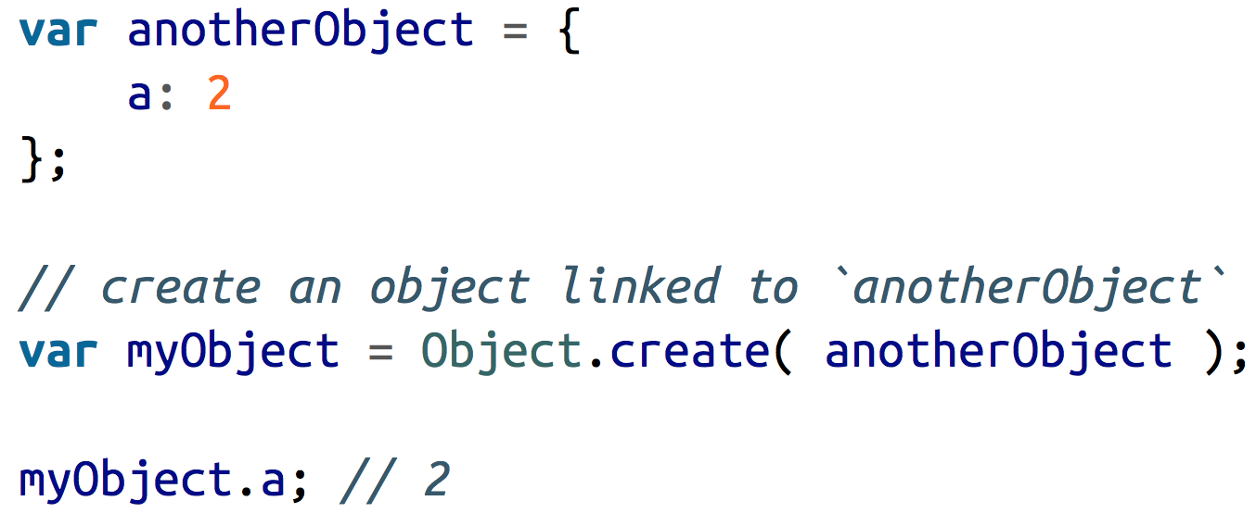
[[GET]] in prototype chain

Slide 10
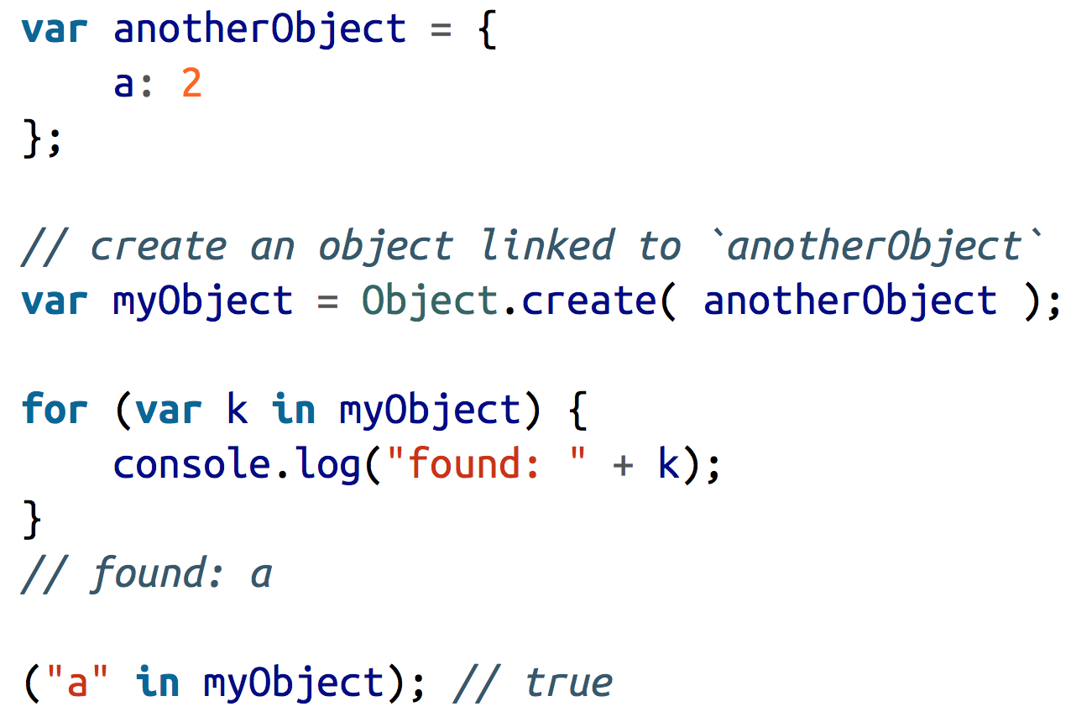
For in?

Slide 11
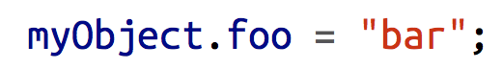
Shadowing in prototype chain
foo found in the prototype chain >> foo isn’t read only >> new property is added to the object and the previous one is shadowed
foo found in the prototype chain >> foo is read only >> you cannot neither create a new property neither modify the previous one
foo found in the prototype chain >> foo is a setter >> you cannot neither create a new property neither modify the previous one
The solution: Object.defineProperty(…);

Slide 12
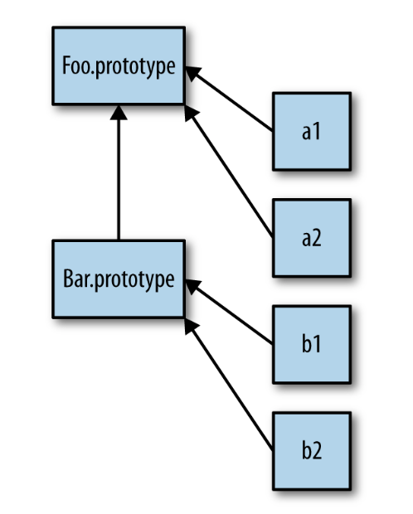
Class, constructor and inheritance

Slide 13
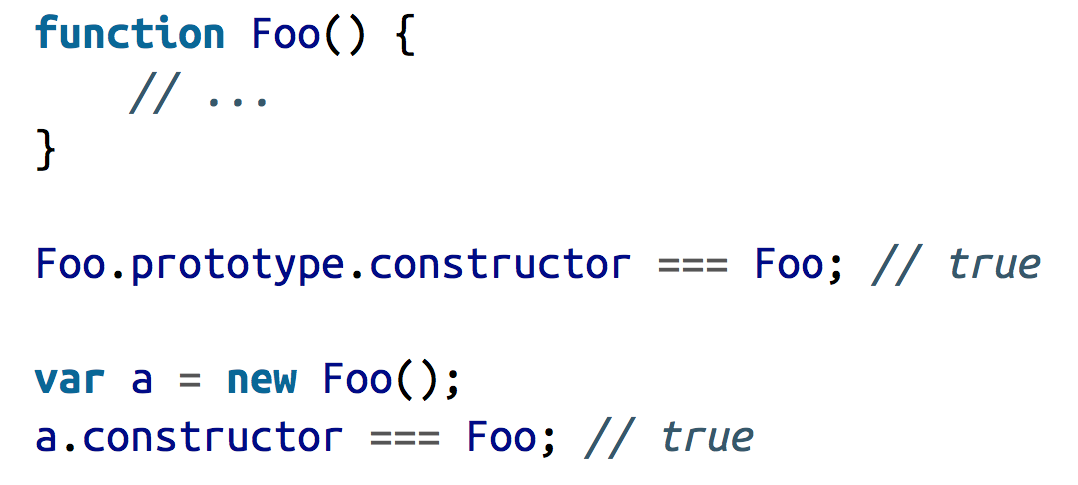
Constructor

Slide 14
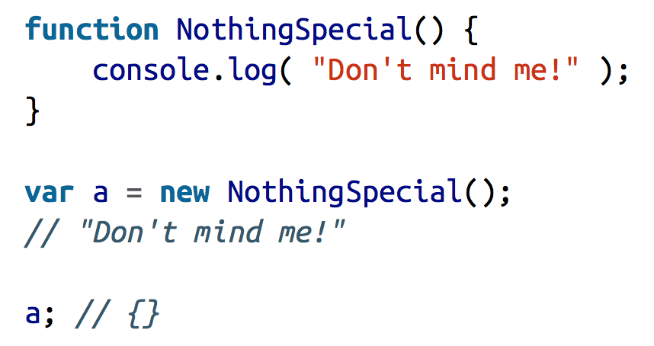
What you construct?
Functions are not constructors, they are just .. normal functions
When you call a function with new, you have a constructor call

Slide 15
Inheritance with prototype

Slide 16
ES6 Class – The modern way

Slide 17
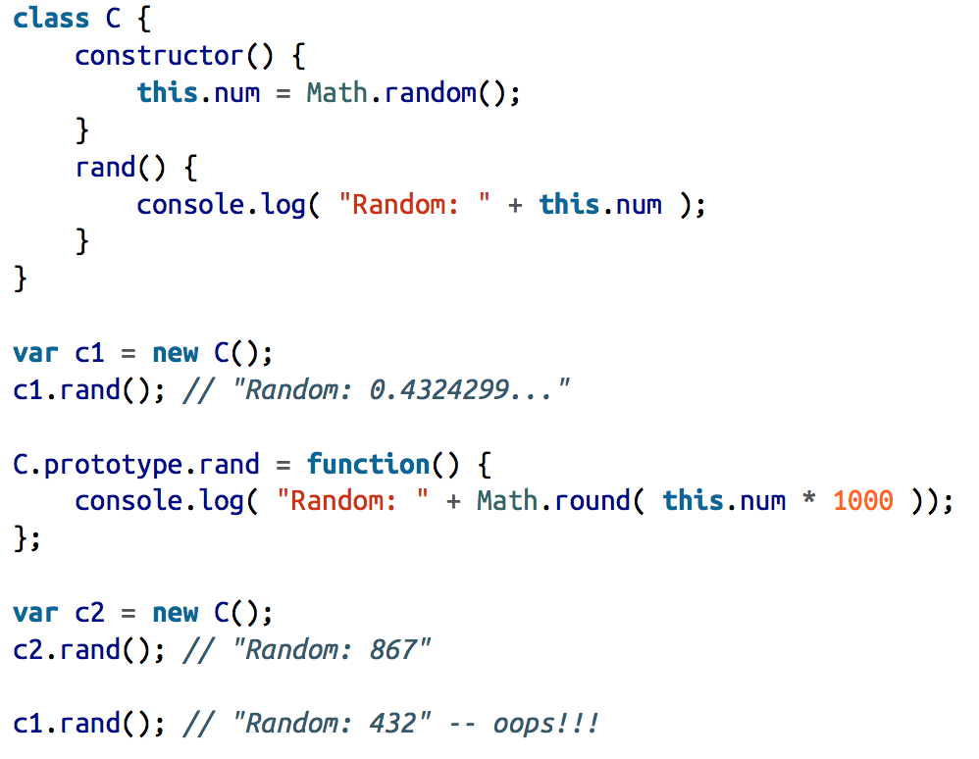
Class – Cotcha

Slide 18
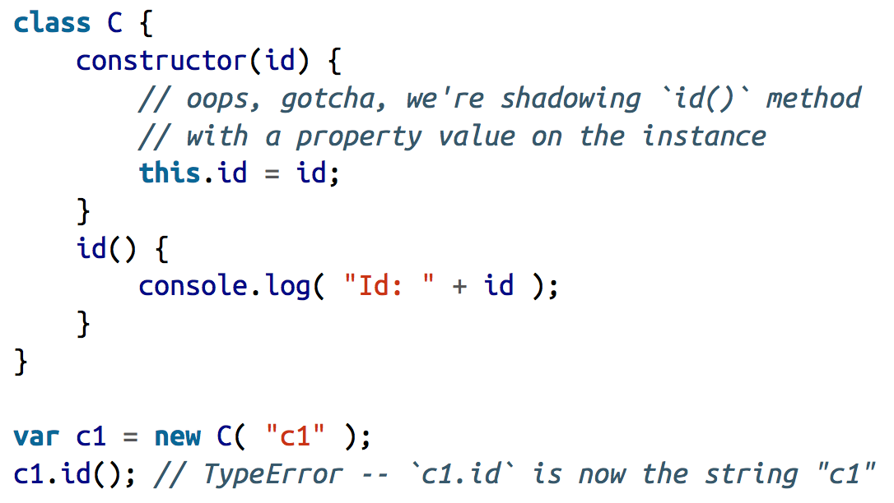
Class – Cotcha

